Slide 1
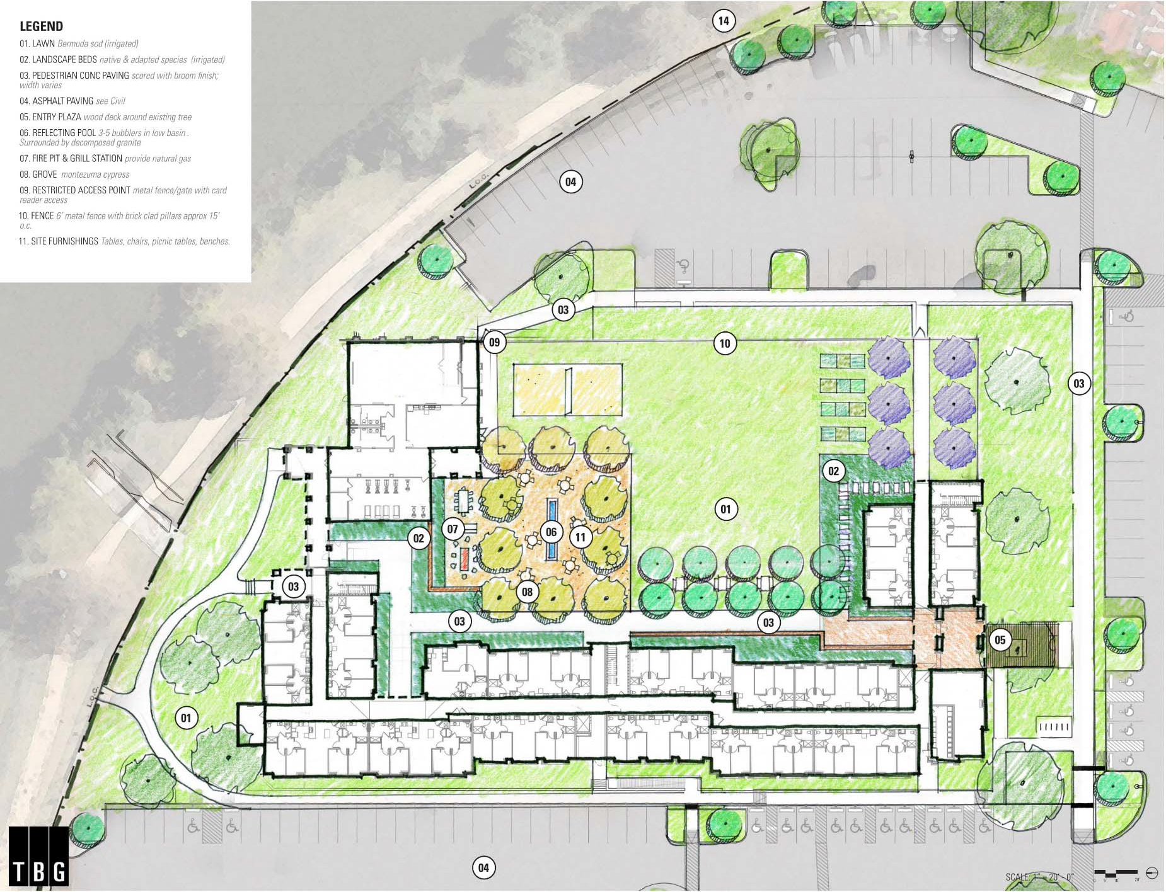

Site Plan/Courtyard Plan

Slide 2
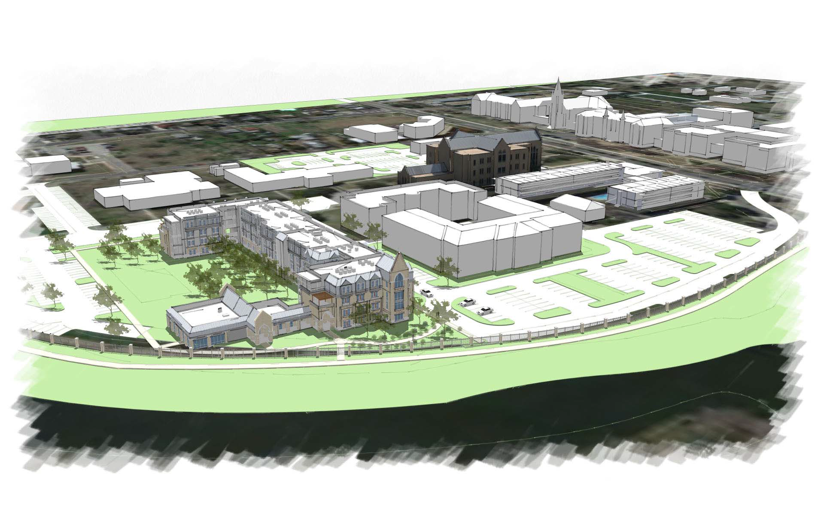

Slide 3
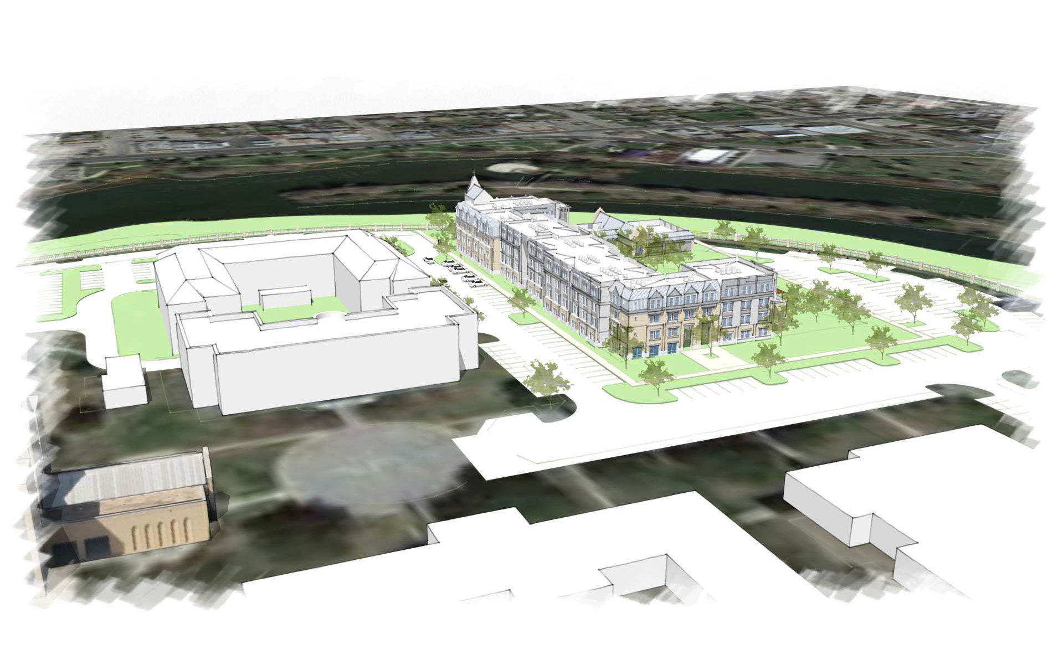

Slide 4
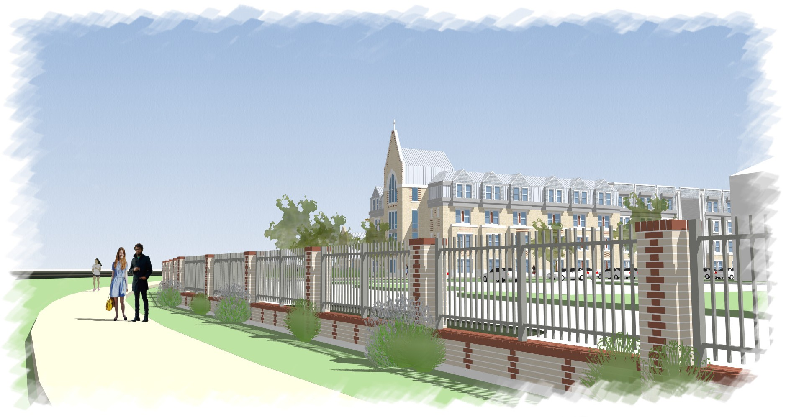

OUR LADY OF THE LAKE - NEW RESIDENTIAL DORMITORY
04-26-2016

Slide 5
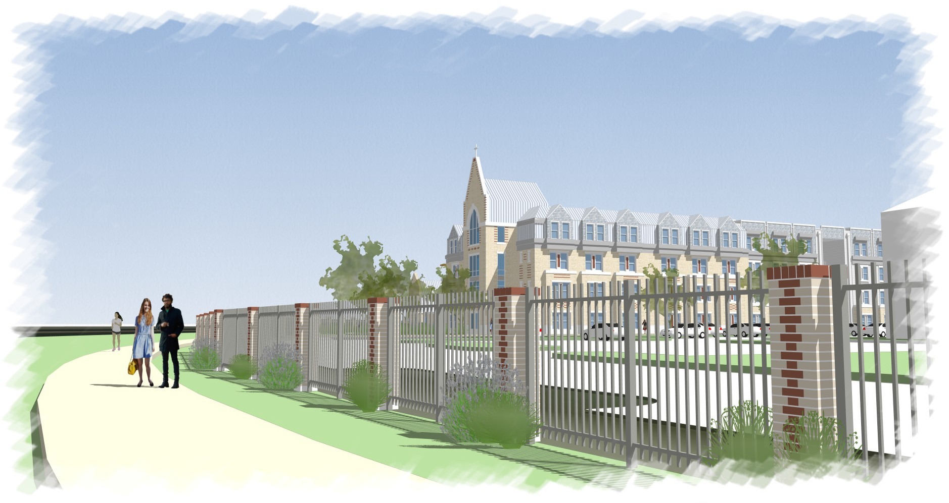
OUR LADY OF THE LAKE - NEW RESIDENTIAL DORMITORY
04-26-2016

Slide 6
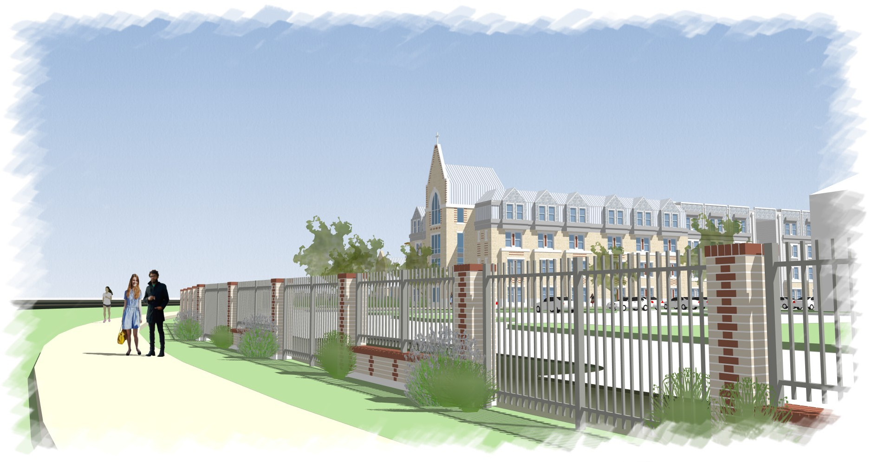
OUR LADY OF THE LAKE - NEW RESIDENTIAL DORMITORY
04-26-2016

