Slide 1
Student Leadership Award Ceremony
Spring 2020

Slide 2
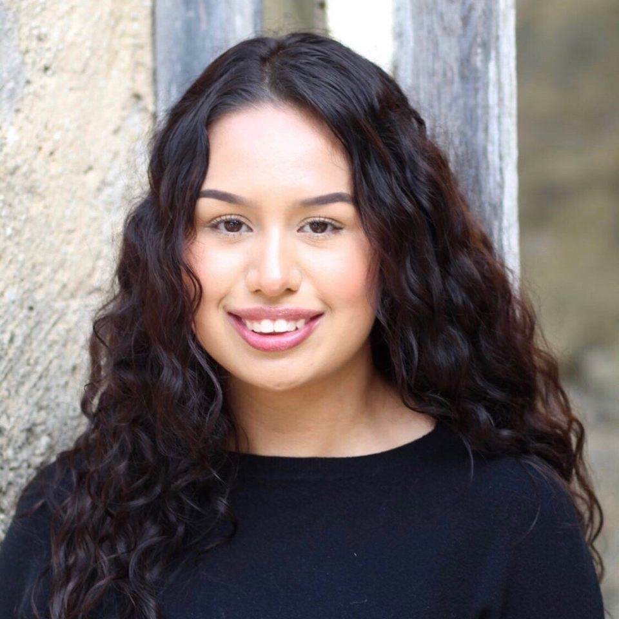
Senior Wings Up Achievement Award
Alyssah Gonzalez

Slide 4
Sr. Margit Nagy CDP Women's Empowerment Award Alyssah Gonzalez

Slide 6
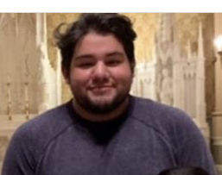
Leadership in Spirituality and Service Award Richard Galvan III

Slide 8
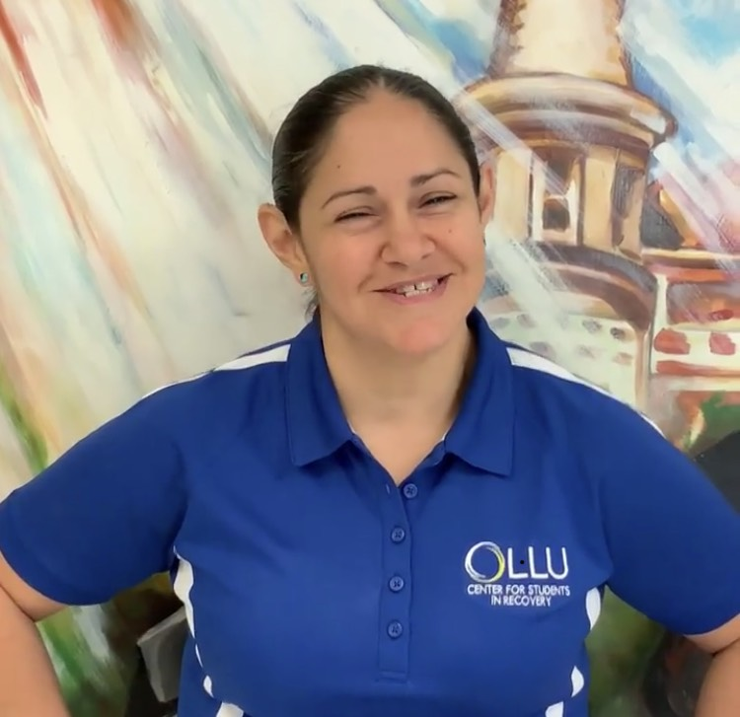
Providence Award Lydia Hamner

Slide 10
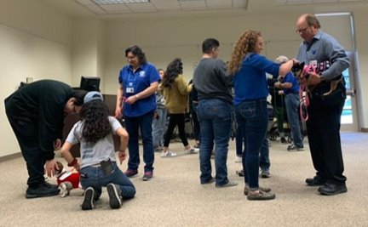
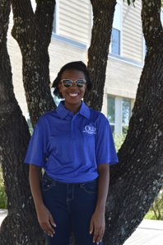
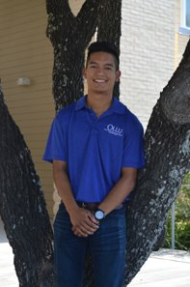
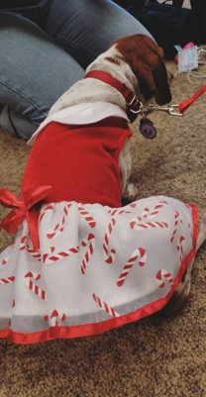
Program of the Year "Paws & Pals" Hosted by: Katie Shamy, Rebekah Wynn & Eric-Tyler Guerrero (pictured left to right)

Slide 12
Rookie of the Year Jasmin Huerta

Slide 14
Resident Assistant of the Year Award Ayala Adams

Slide 16
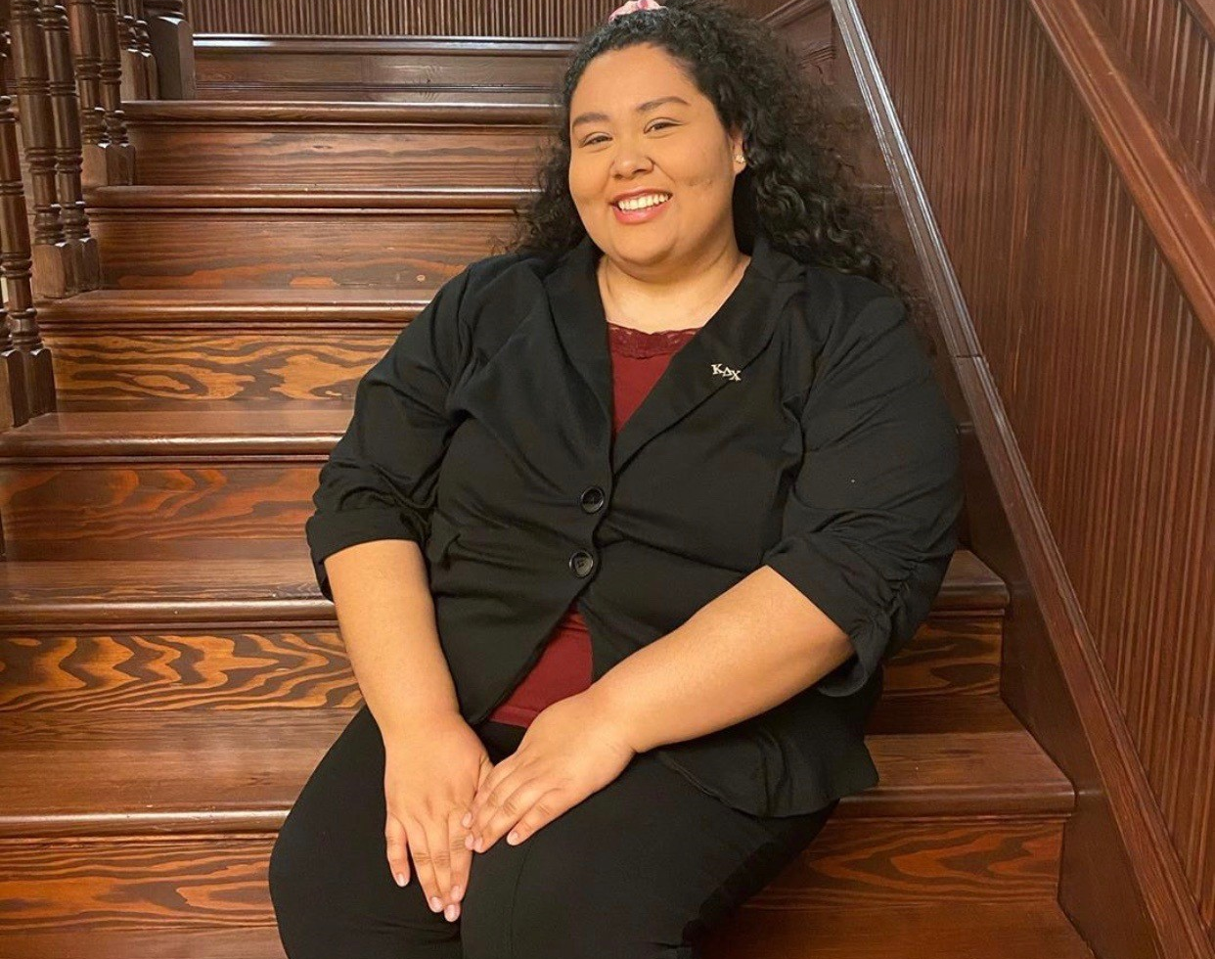
Outstanding Service Leader Award

Slide 18
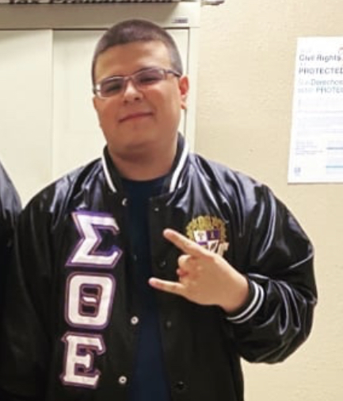
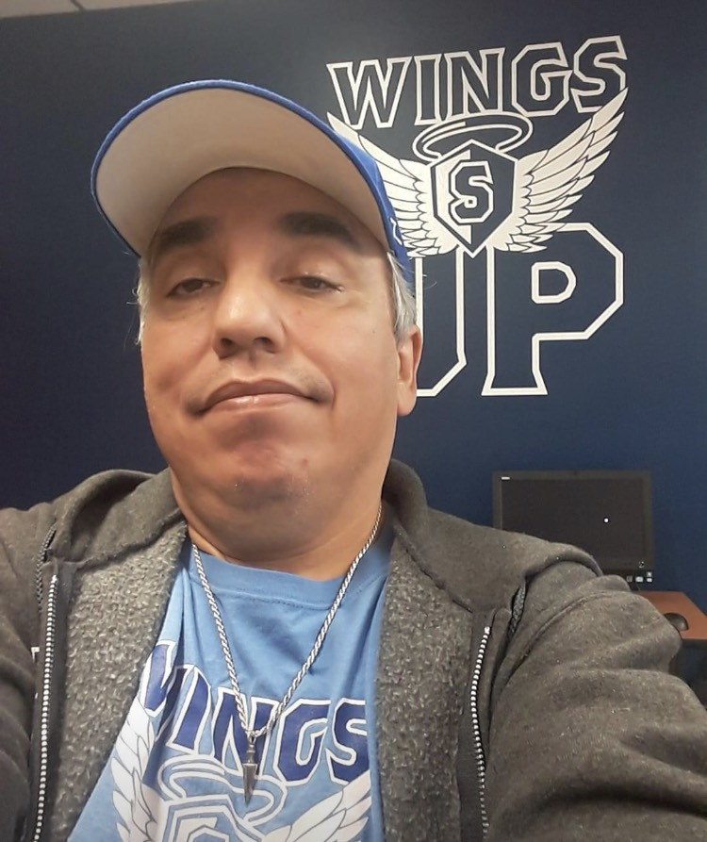
President's Volunteer Service Award
Jesus Rodriguez Peter Apaez

Slide 20
Academic Excellence Award: Chartered Student Organization Saints Productions Board Overall G.P.A of 3.4

Slide 22
Academic Excellence Award : Special Interest Organization Lions Club Overall G.P.A of 3.7

Slide 24
Academic Excellence Award: Academic Organization Saints Accounting Club Overall G.P.A of 3.77
Saints Accounting Club

Slide 26
Academic Excellence Award: Greek Organization
Kappa Delta Chi Overall G.P.A of 3.43

Slide 28
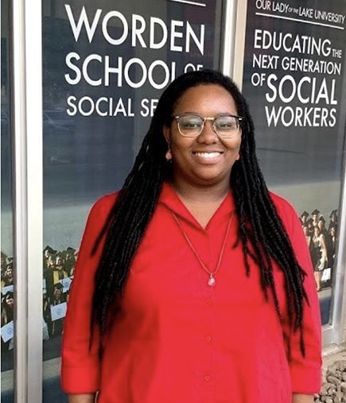
Engaged Advisor Award Dr. Rosalind Evans, Advisor of The Alliance

Slide 30
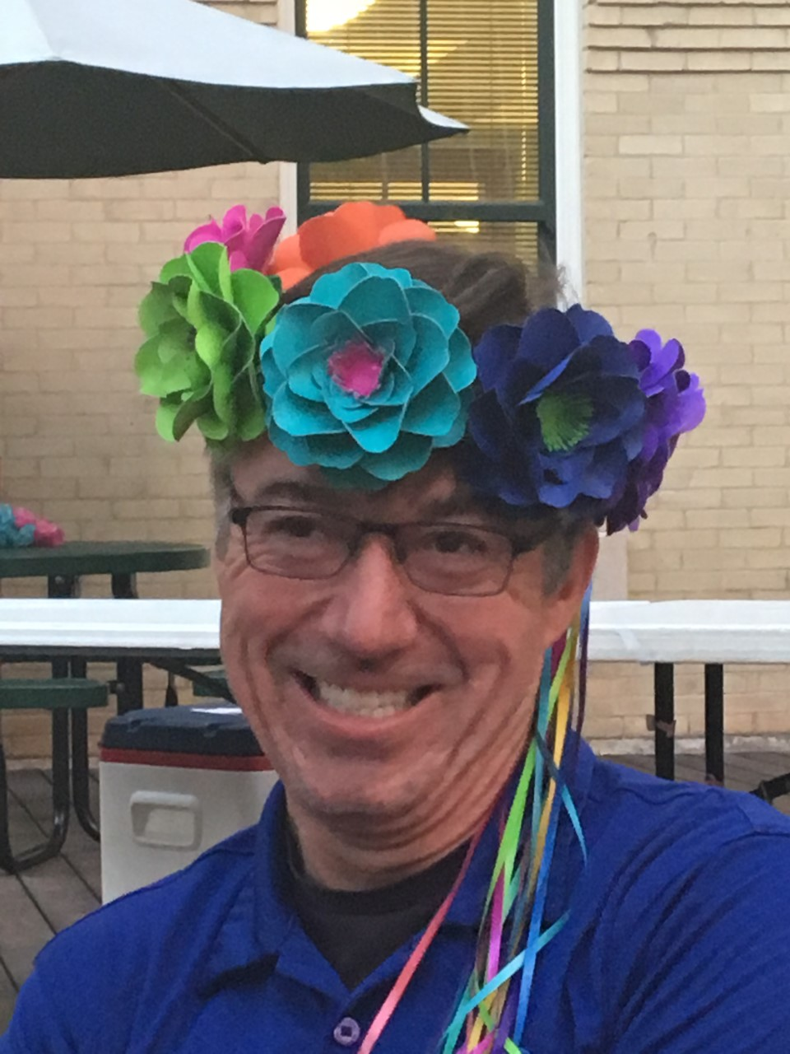
Heart of OLLU Award
Mr. Darrell Glasscock, Director of Facilities Management

Slide 32
Unsung Hero Award Getsemani Arteaga, MASA

Slide 34
Unsung Hero Award
Brianna Munoz-Rabb, Criminal Justice Society

Slide 36
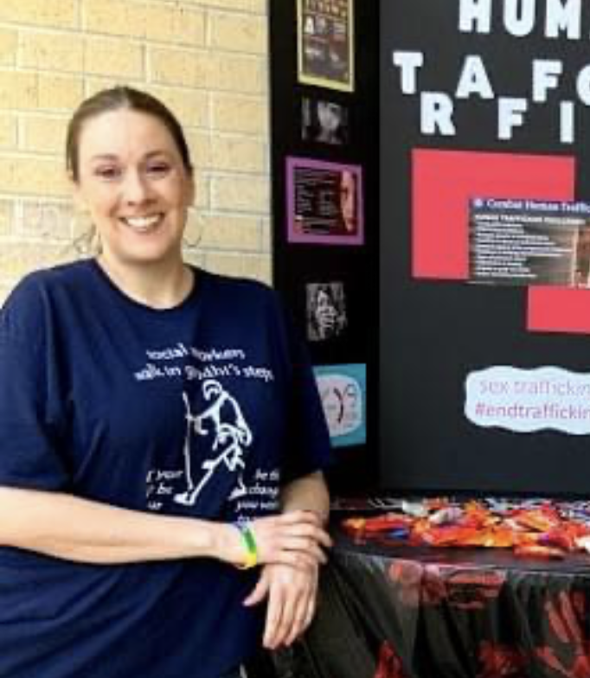
Unsung Hero Award Jaime Nicholson, Student Veterans of America

Slide 38
Unsung Hero Award Isabel Rodriguez, The Alliance

Slide 40
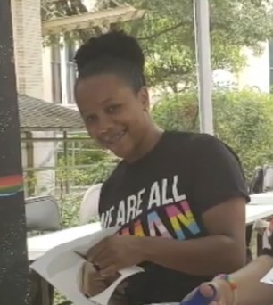
Bridge Builder Award
Natasha Glenn, The Alliance

Slide 42
Bridge Builder Award
Robert Oliva Jr., Saints Greek Council

Slide 44
Rising Star Leader Award Nora Anda,
Student Government Association

Slide 46
Rising Star Leader Award Marinela Briseno-Hernandez,
Volunteer Unity Council

Slide 48
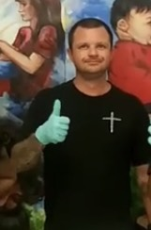
Rising Star Leader Award Van Cormier,
Student Veterans of America

Slide 50
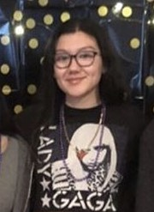
Rising Star Leader Award Adriana Medina,
The Alliance

Slide 52
Rising Star Leader Award Vivian Najar,
The Alliance

Slide 54
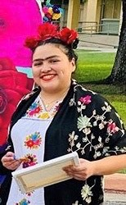
Rising Star Leader Award
Mia Sanchez,
MASA

Slide 56
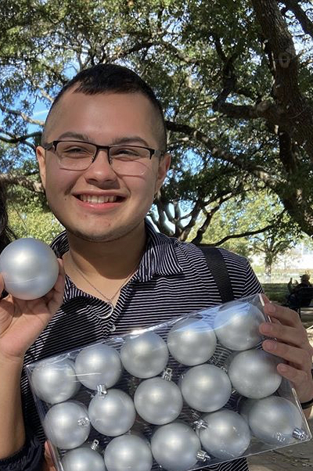
Rising Star Leader Award John Segovia,
Saints Productions Board

Slide 58
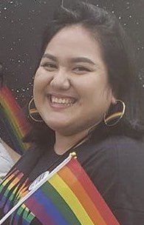
Student Leader Excellence Award
Anna Boone, The Aliance

Slide 60
Student Leader Excellence Award
Lauryn Castro, NSSLHA

Slide 62
Student Leader Excellence Award
Brandon Celedon, Criminal Justice Society

Slide 64
Student Leader Excellence Award
Jeremy Falkner, Student Veterans of America

Slide 66
Student Leader Excellence Award
Natasha Glenn, The Alliance

Slide 68
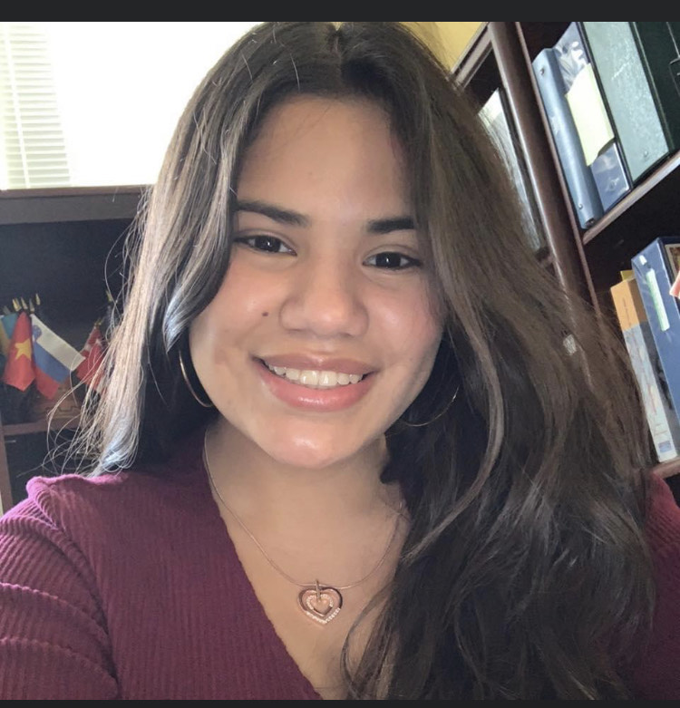
Student Leader Excellence Award
Victoria Herrera, MASA

Slide 70
Student Leader Excellence Award
Marisol Mesa, Saints Productions Board

Slide 72
Student Leader Excellence Award
Tricille Otineru, Student Veterans of America

Slide 74
New RSO of the Year Award
First Generation Student Organization

Slide 76
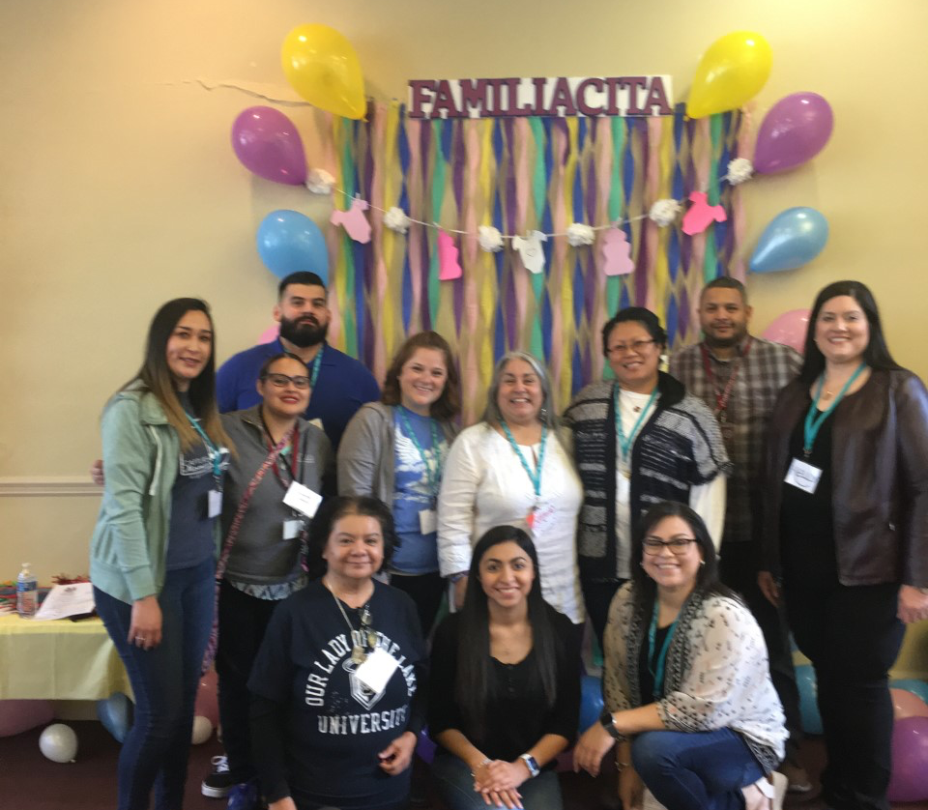
Innovation Award
Worden Social Work Organization's
Familiacita: Young Parents Expo

Slide 78
RSO Beacon Award
The Alliance

Slide 80
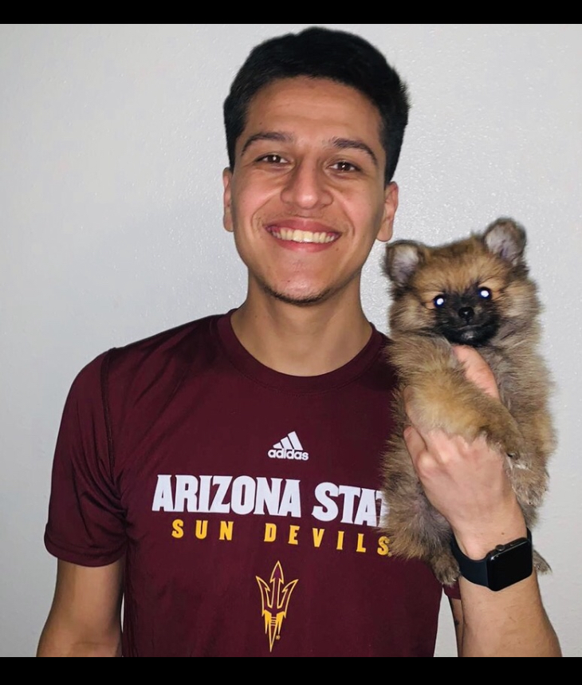
OLLU Achievement Award
Humberto Becerra

Slide 82
OLLU Achievement Award
Alyssah Gonzalez

Slide 84
OLLU Achievement Award
Genoveve Gutierrez

Slide 86
vOLLU Achievement Award
Priscilla Martinez

Slide 88
OLLU Achievement Award
Alexis Medrano

Slide 90
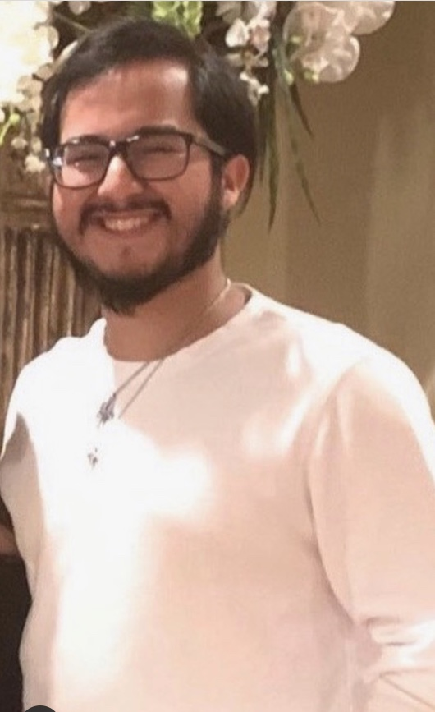
OLLU Achievement Award
Robert Oliva Jr.

Slide 92
OLLU Achievement Award
DiAnna Santillan

Slide 94
OLLU Achievement Award
Crystal Venegas

Slide 96
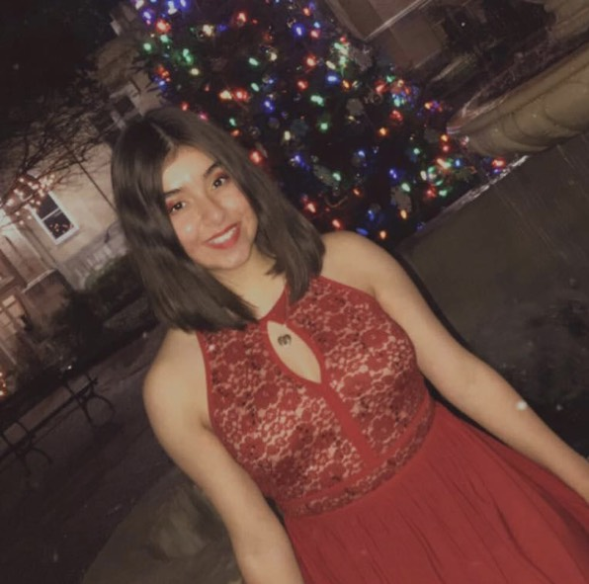
St. Catherine Medal Recipient
Kimberlee Flores

Slide 98
A special thanks to those who made tonight possible.

