Slide 1


2020 United Way Ambassador Meeting
October 16, 2020
Notes:
Start recording!
Cyndi will open the meeting with a prayer.

Slide 2

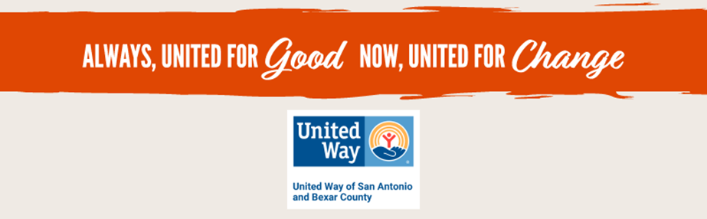
Notes:
“The City of Flowers” - Gio Dizurita ©2020 United Way of San Antonio and Bexar County ALWAYS UNITED FOR GOOD NOW UNITED FOR CHANGE.

Slide 3
Introductions
Mary Scotka mscotka@ollusa.edu
Cyndi Treviño ctrevino1@ollusa.edu
Employee Campaign Chairs
Notes:
Objective
To introduce yourself as the Employee Campaign Manager (ECM), and share your role in campaign
To introduce your United Way Staff Partner
Sample script:
Thank you for joining us today!
My name is [Your Name Here] and with me today is [UWSA Representative Name]. We’re excited to welcome you to our 2020 United Way Campaign!
I am proud to chair our organization’s campaign this year. Things might look a little different this campaign, but we’re excited to provide new and creative ways in which we will bring our colleagues together and make a positive impact in our community.
We have a busy agenda today…Next Slide

Slide 4
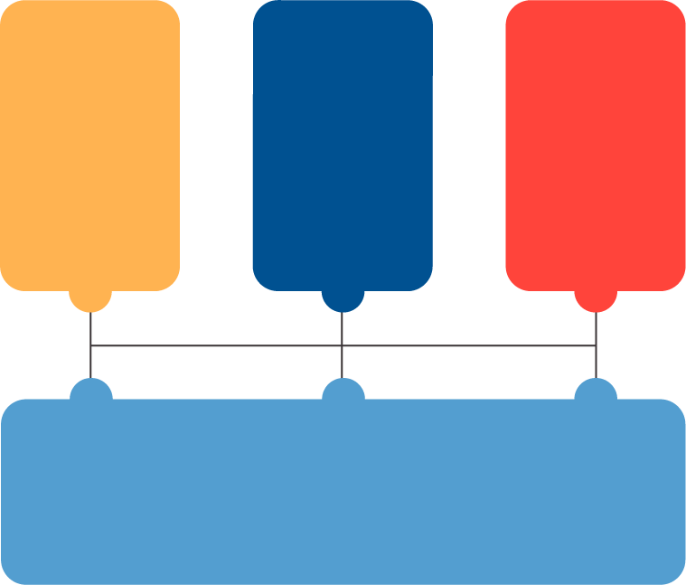




Impact Areas
Strong Individuals
and Families
Impact Council
Ready Children
Impact Council
Successful Students
Impact Council
Safety Net Services
Impact Council
Notes:
UW is strategically realigning to address future challenges of a changing operating environment while honoring our strong history of helping others to affect community change. No one organization can tackle the challenges of the 21st century alone. We are using a collective impact approach to create a positive impact for San Antonio’s most pressing needs.
We have 4 focus areas:
Ready Children: Focused on ensuring all children are happy, healthy and ready to enter kindergarten and succeed in school
Successful Students: Is intent on helping young adults 0 to 24 grow, graduate and become successful adults.
Strong Individuals and Families: Recognizes the need for a support system that provides individuals and families the opportunity to achieve self-sufficiency.
Safety Net: Supports emergency and disaster care services to help stabilize individuals and families, meeting their most immediate needs.
Each focus area has an Impact Council in order to enhance the system of services:
The Impact Council membership includes people from diverse sectors of the community: volunteers, funders, content experts, public sector partners and residents.
We began our alignment with Ready Children, Successful Students and Strong Individuals and Families.
Intentionally delayed Safety Net in order to better understand how we can integrate those resources to support the work of the other three councils.

Slide 5
United Way’s Impact - COVID-19
Survey of Agencies Regarding Impact of COVID-19
2-1-1 United Way Helpline
COVID-19 Community Response Fund
SAUnited4Good.com
United Way Community “Thank-A-Thon”
COVID-19 Emergency Childcare Assistance Program ($400,000)
Get Shift Done – San Antonio ($600,000)
Mayor’s COVID-19 Response Task Force – Philanthropy & Social Services Work Groups
Notes:
Survey of Agencies Regarding Impact of COVID-19
Weekly survey to all local nonprofits
Shifting to recovery question set
2-1-1 United Way Helpline
Call specialists working in building and remote
Call volume stabilizing in June
COVID-19 Community Response Fund
Established in partnership with San Antonio Area Foundation
Current total - $6.3M / $5.1M in grants
SAUnited4Good.com
Virtual volunteer opportunities
Available to all community nonprofits
United Way Community “Thank-A-Thon”
Online portal created to collect public messages
COVID-19 Emergency Childcare Assistance Program ($400,000)
Covers 3 weeks childcare costs for parents who must leave home to go to work
Funding provided by Women United, City of San Antonio and San Antonio Area Foundation
Get Shift Done – San Antonio ($600,000)
Supports hospitality workers by paying for volunteer work with local nonprofits - 600+ registrants
Mayor’s COVID-19 Response Task Force – Philanthropy & Social Services Work Groups
Joining with community leaders to develop a coordinated response
Impact of COVID-19
Presented by United Way Staff – 30 seconds
Facilitator note: If United Way staff are unavailable, the ECM can present this portion of the agenda.
Objective
To share information about the issues facing our community and what United Way is doing to improve conditions for the most vulnerable
Sample script;
No one could have ever predicted the size, scope and scale of the global crisis that unfolded in real-time in neighborhoods and communities around the world—and across Bexar County--as a result of COVID-19.
Our residents, families and neighborhoods have been pushed to their limits, and beyond, in many cases. And our local nonprofits are stretching beyond their limits to serve them. With the economic shut-down, the number of people who need our services has climbed drastically. As emergency needs and priorities continue to evolve, we know for certain that recovery will take months and, more likely, years.
[Speak to one or two of the above responses United Way did for our community]
Even so, the sustaining truth that we have seen in action is that community matters. Research has shown that in times of crisis, the stronger the sense of connection—local people working together—the more resilient the community. We are stronger because we’re in it together. The reality is our community needs your help more than ever this year!

Slide 6
United Way Addresses Inequity
United Way has a history of addressing economic and social disparities, specifically for our neighborhoods of color.
United Way expanded its strategic focus to support and invest in Impact Council equity initiatives that further advance our community.
United Way strengthened its equity work by developing a cohesive plan, through the Eastside Promise Zone and Dual Generation initiatives, to bolster families across generations in historically underserved communities.
United Way secured additional grants that support family protective and prevention services focused on reducing child abuse and domestic violence in military and civilian households.
Notes:
United Way has a history of addressing economic and social disparities, specifically for our neighborhoods of color.
United Way expanded its strategic focus to support and invest in Impact Council equity initiatives that further advance our community.
United Way strengthened its equity work by developing a cohesive plan, through the Eastside Promise Zone and Dual Generation initiatives, to bolster families across generations in historically underserved communities.
United Way secured additional grants that support family protective and prevention services focused on reducing child abuse and domestic violence in military and civilian households.

Slide 7
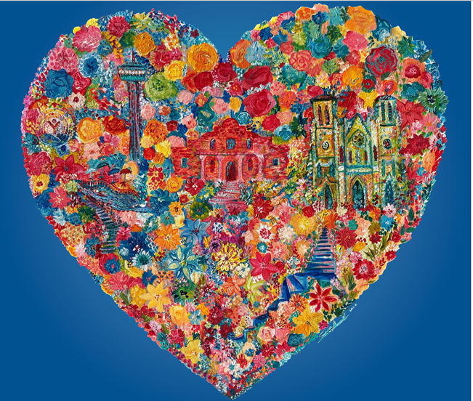
All OLLU Employees encouraged to support United Way
Show Your Spirit of Service and Community!
Contributions support United Way Impact Areas:
Ready Children, Successful Students, Strong Individuals & Families and Safety Net Services
Employees are asked to make your donation pledge online using the
United Way E-Pledge portal at www.giveuw.org/OLLU
Funds may be designated to specific community partners (https://www.unitedwaysatx.org/partners/)
Contact Mary Scotka (Prov. 2C) or Cyndi Trevino (Moye 110) for more information.
Notes:
Add original flyer

Slide 8
YOU Can Make A Difference!
Consider Making a donation
Your donation has a direct impact on one of your neighbor's lives.
Be an advocate for United Way
Volunteer at our Service Project
Our community needs us!
Notes:
Please Give Generously
Presented by CEO/ECM – 1 minute
Objective
To make a clear call to action for giving to United Way
To provide the CEO and ECM the opportunity to thank employees for their participation
Sample script:
We need your help and ask that you please join us in keeping our community strong. We can’t do it without you. Please consider a contribution of either one hour pay per month or 1% of your salary. You will truly help to change a life!
By participating in our United Way campaign, you are helping people who need it most, connecting them to the resources and support they need to thrive.
When you receive your pledge or link to donate, your gift will help us reach our campaign goal of [INSERT GOAL]. You can expect your United Way representative to connect with you to answer any questions you may have.
Thank you again for your time and participation, and I look forward to celebrating our success at the wrap up of our campaign on [DATE]!

Slide 9
What are we asking of our ambassadors?
Be an advocate for our campaign. Be our voice.
Our OLLU goal is 100% participation.
Donations can be payroll deducted
Partner Agency List
Direct to OLLU E-Pledge Portal http://giveuw.org/OLLU
List of prizes
Notes:
Please Give Generously
Presented by CEO/ECM – 1 minute
Objective
To make a clear call to action for giving to United Way
To provide the CEO and ECM the opportunity to thank employees for their participation
Sample script:
We need your help and ask that you please join us in keeping our community strong. We can’t do it without you. Please consider a contribution of either one hour pay per month or 1% of your salary. You will truly help to change a life!
By participating in our United Way campaign, you are helping people who need it most, connecting them to the resources and support they need to thrive.
When you receive your pledge or link to donate, your gift will help us reach our campaign goal of [INSERT GOAL]. You can expect your United Way representative to connect with you to answer any questions you may have.
Thank you again for your time and participation, and I look forward to celebrating our success at the wrap up of our campaign on [DATE]!

